Slide 1
Dr. Rammanohar Lohia Avadh University, Ayodhya
Institute of Engineering and Technology
“Scouting for the safest area”
Presented by
Vaqash Khan (17140)
Hiya (17115)
Vanshika Tiwari (17139)
Zahida Bano (17144)
Under the supervision of
Er. Ashish Kumar Pandey
Session 2020-2021

Slide 2
Background
An average person moves around 5 times in their lifetime. This brings us to the question: “Do people move until they find a place to settle down where they truly feel happy, or do our wants and needs change over time, prompting us to eventually leave a town we once called home for a new area that will bring us satisfaction? Or, do we too often move to a new area without knowing exactly where we’re getting into, forcing us to turn tail and run at the first sign of discomfort?”

Slide 3
Background contd.
To minimize the chances of this happening, we should always do a proper research when planning our next move in life. You have to consider some factors when picking a new place to live, so you don’t end up wasting your valuable time and money making a move you’ll end up regretting.

Slide 4
Reasons to choose this project
Increase in violence in different areas of the country.
Shifting of large number of people from one country to another.
To find a peaceful place to live.
To find the safest area.
To find a place where we could get everything of our need.

Slide 5
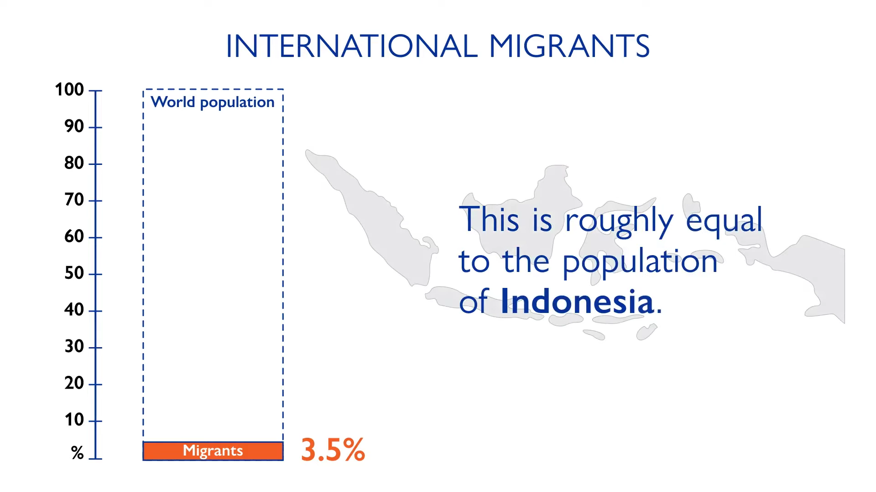
Fig. 1[1]

Slide 6
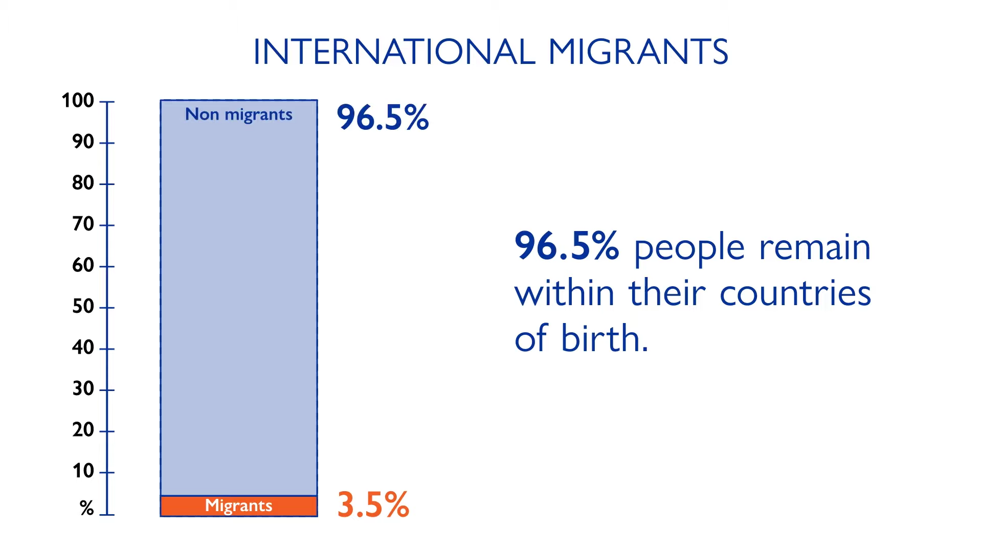
Fig. 2[1]

Slide 7
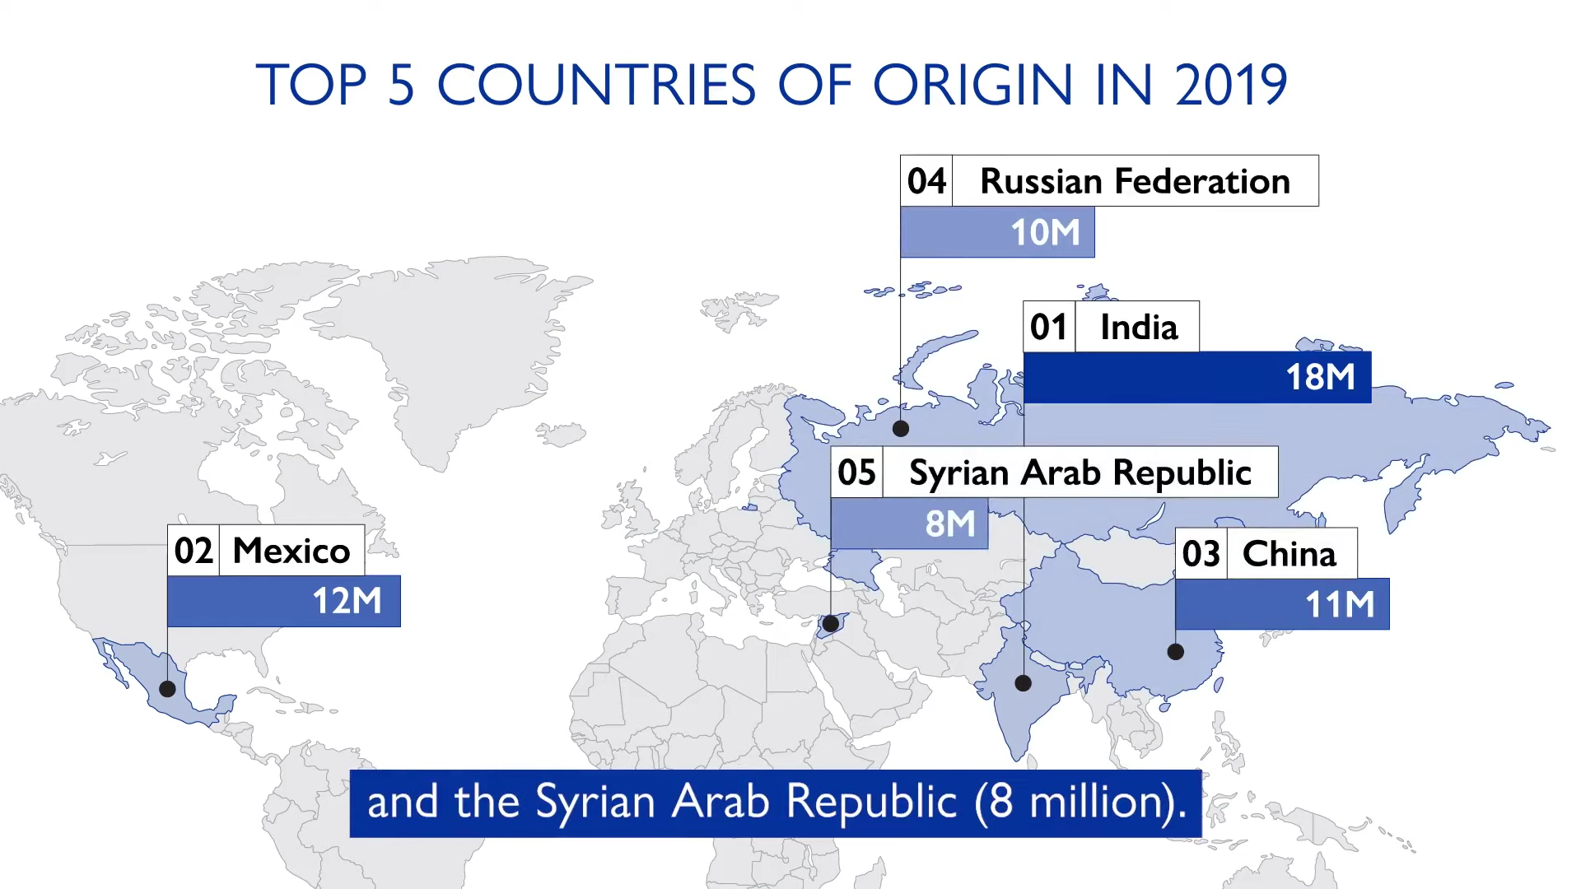
Fig. 3[1]

Slide 8
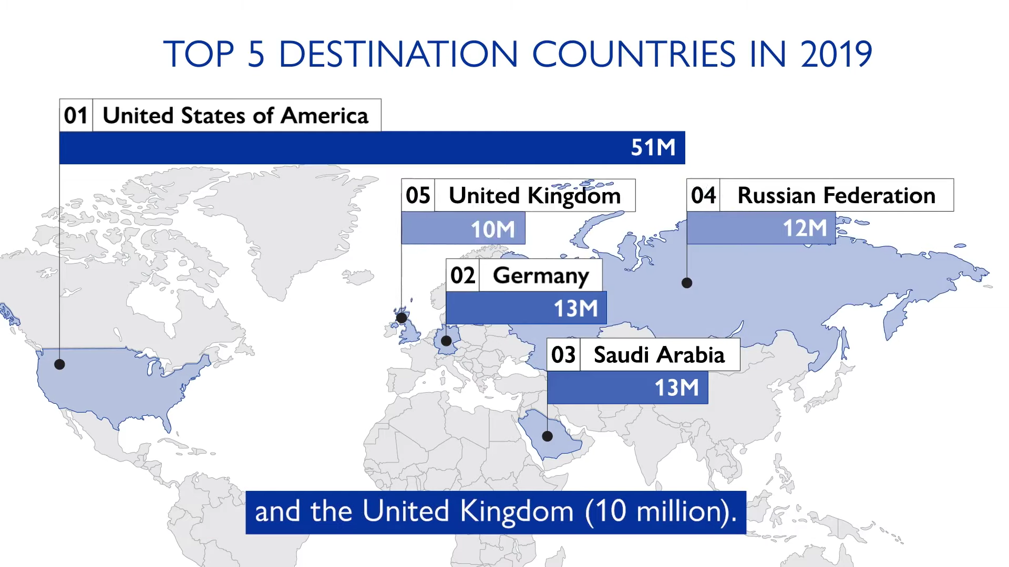
Fig. 4[1]

Slide 9
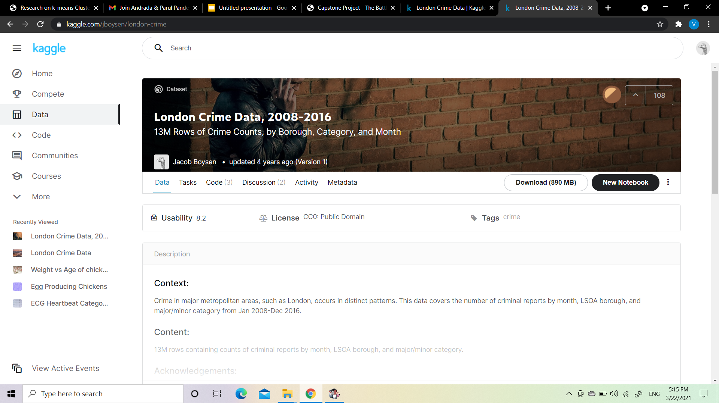
Reasons to choose London
The data is easily available on Kaggle, Wikipedia.
The size of data is enough for computation by our computer’s processor.
Fig. [2]

Slide 10
Parameters Listed
● lsoa_code: Code for Lower Super Output Area in Greater London.
● borough: Common name for London borough.
● major_category: High level categorization of crime.
● minor_category: Low level categorization of crime within the major category.
● value: Monthly reported count of categorical crime in a given borough.
● year: Year of reported counts, 2008-2016.
● month: Month of reported counts, 1-12.

Slide 11
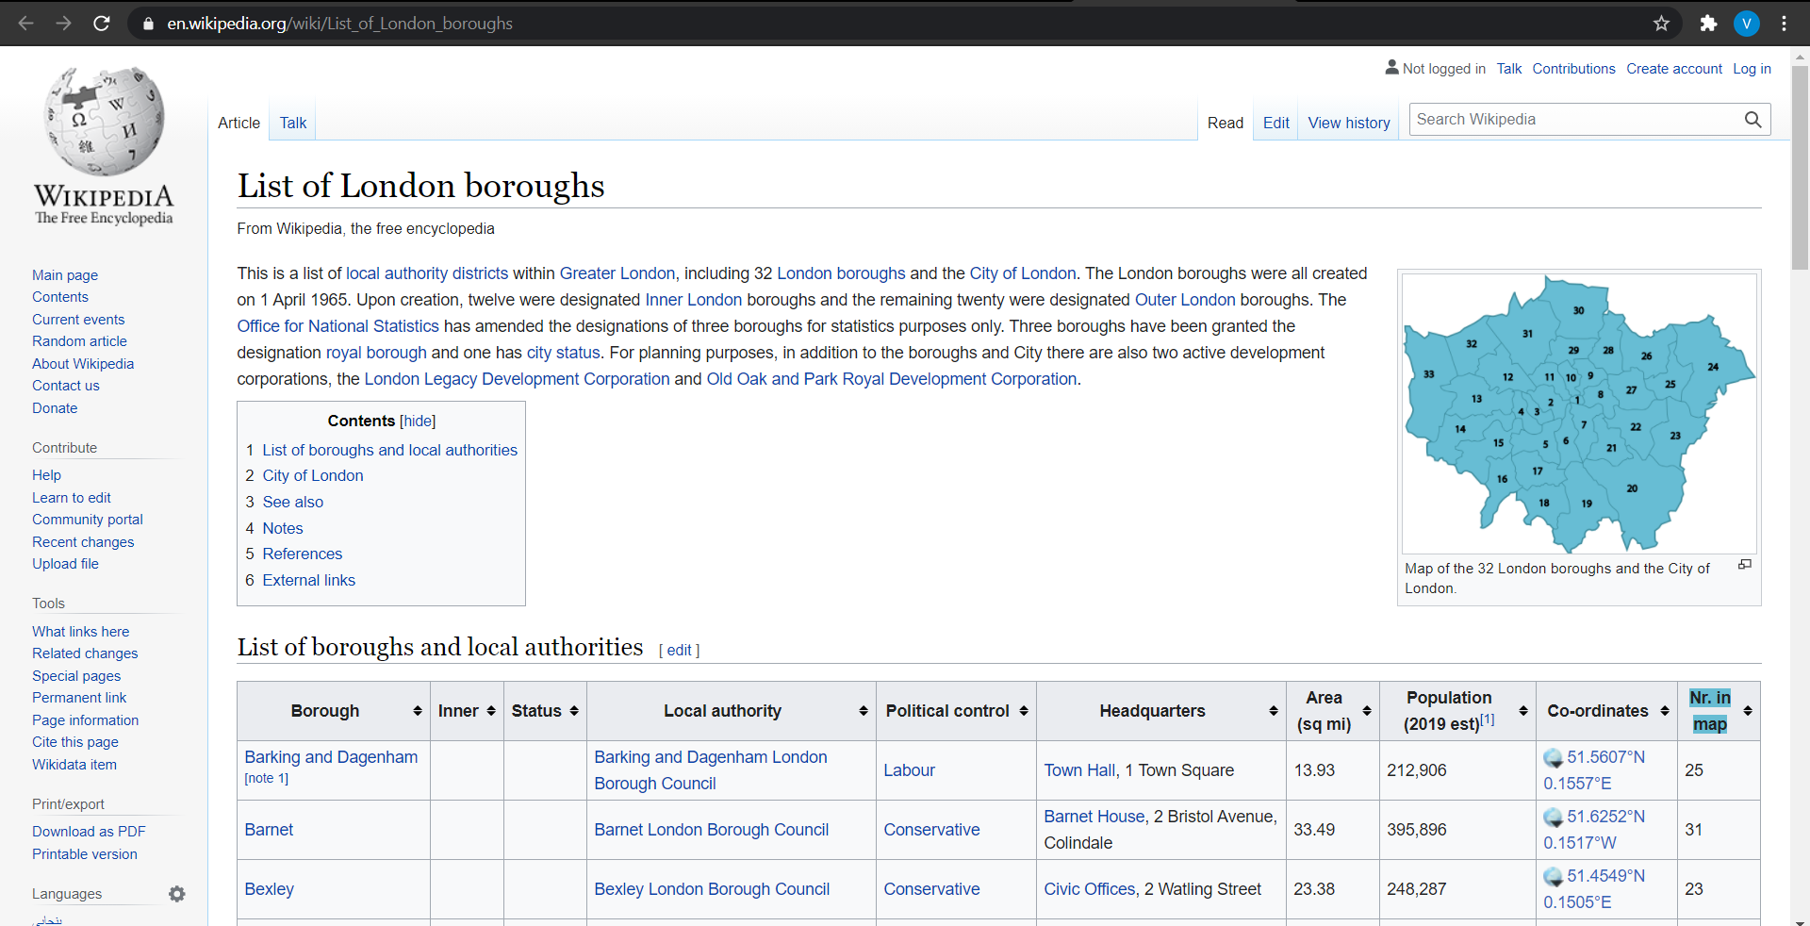
Fig. [3]

Slide 12
Parameters Listed
● Borough: The names of the 33 London boroughs.
● Inner: Categorizing the borough as an Inner London borough or an Outer London Borough.
● Status: Categorizing the borough as Royal, City or other borough.
● Local authority: The local authority assigned to the borough.
● Political control: The political party that controls the borough.
● Headquarters: Headquarters of the Boroughs.
● Area (sq mi): Area of the borough in square miles.
● Population (2013): The population in the borough recorded during the year 2013.
● Co-ordinates: The latitude and longitude of the boroughs.
● Nr. in map: The number assigned to each borough to represent visually on a map.

Slide 13
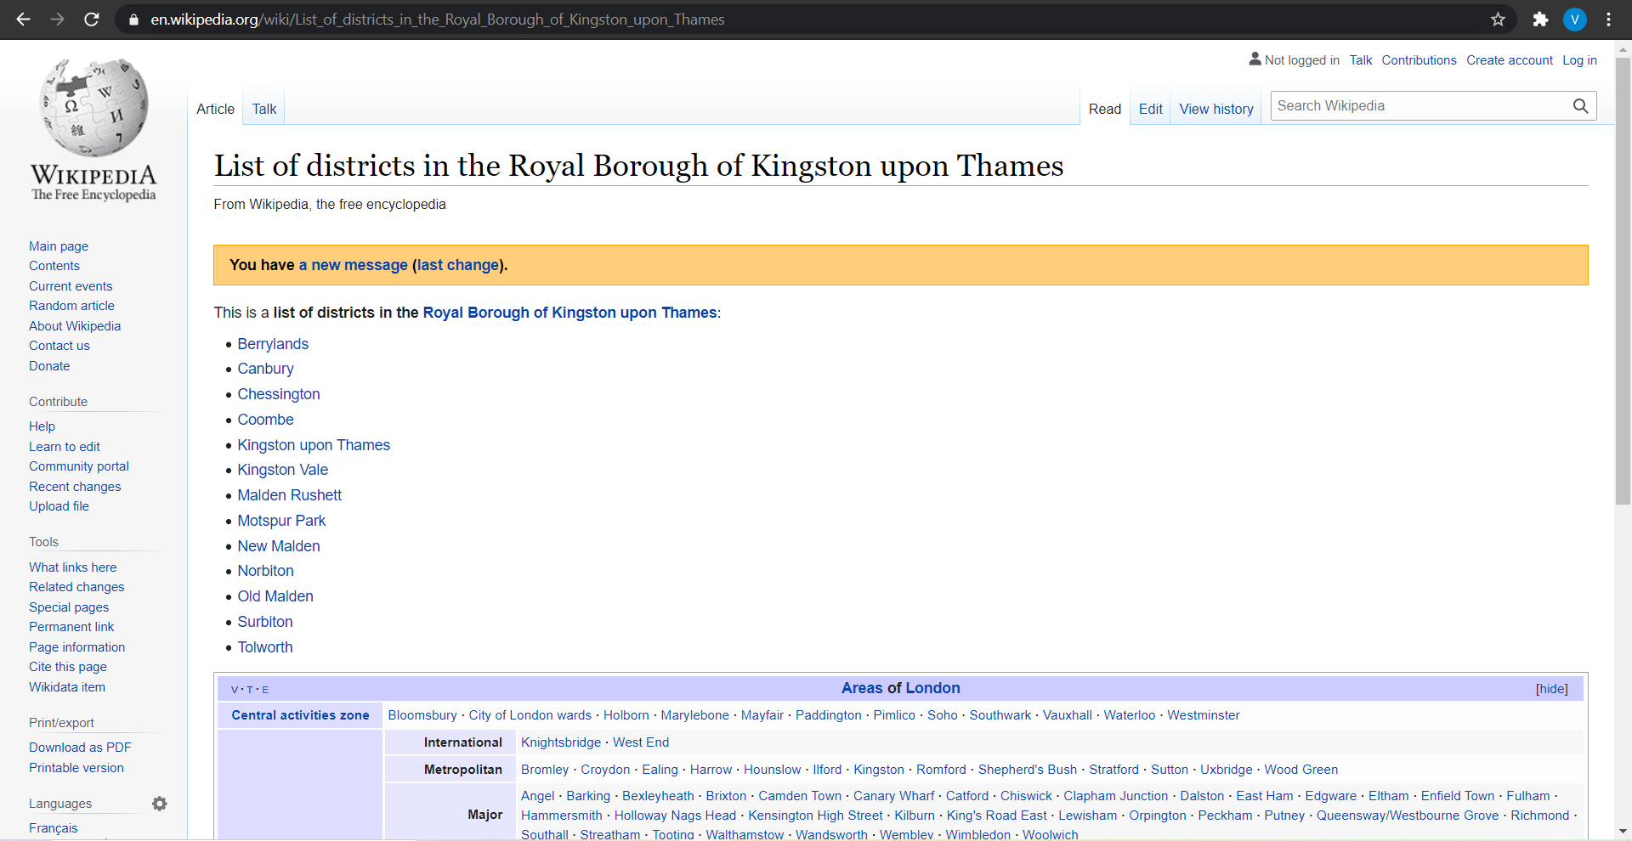
Fig. [4]

Slide 14
Parameters Listed
● Neighborhood: Name of the neighborhood in the Borough.
● Borough: Name of the Borough.
● Latitude: Latitude of the Borough.
● Longitude: Longitude of the Borough.

Slide 15
Problem Statement and Interests
Problem Statement : This project aims to select the safest borough in London based on the total crimes, explore the neighborhoods of that borough to find the 10 most common venues in each neighborhood and finally cluster the neighborhoods using K-Means Clustering.
Interests : Expats who are considering to relocate to London will be interested to identify the safest borough in London and explore its neighborhoods and common venues around each neighborhood.

Slide 16
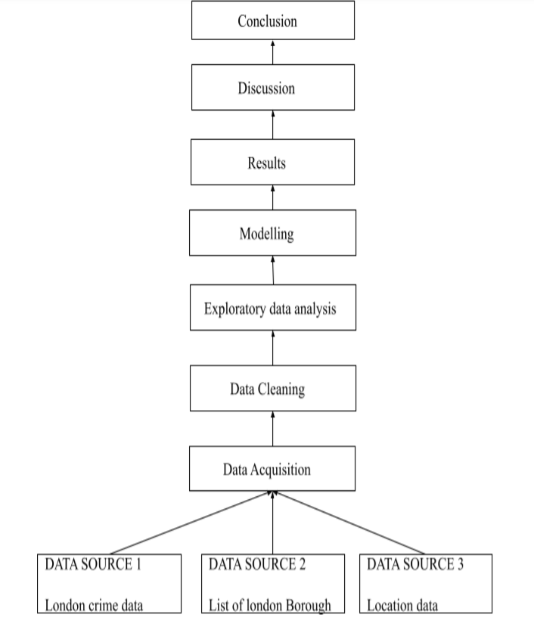
Steps included in our project

Slide 17
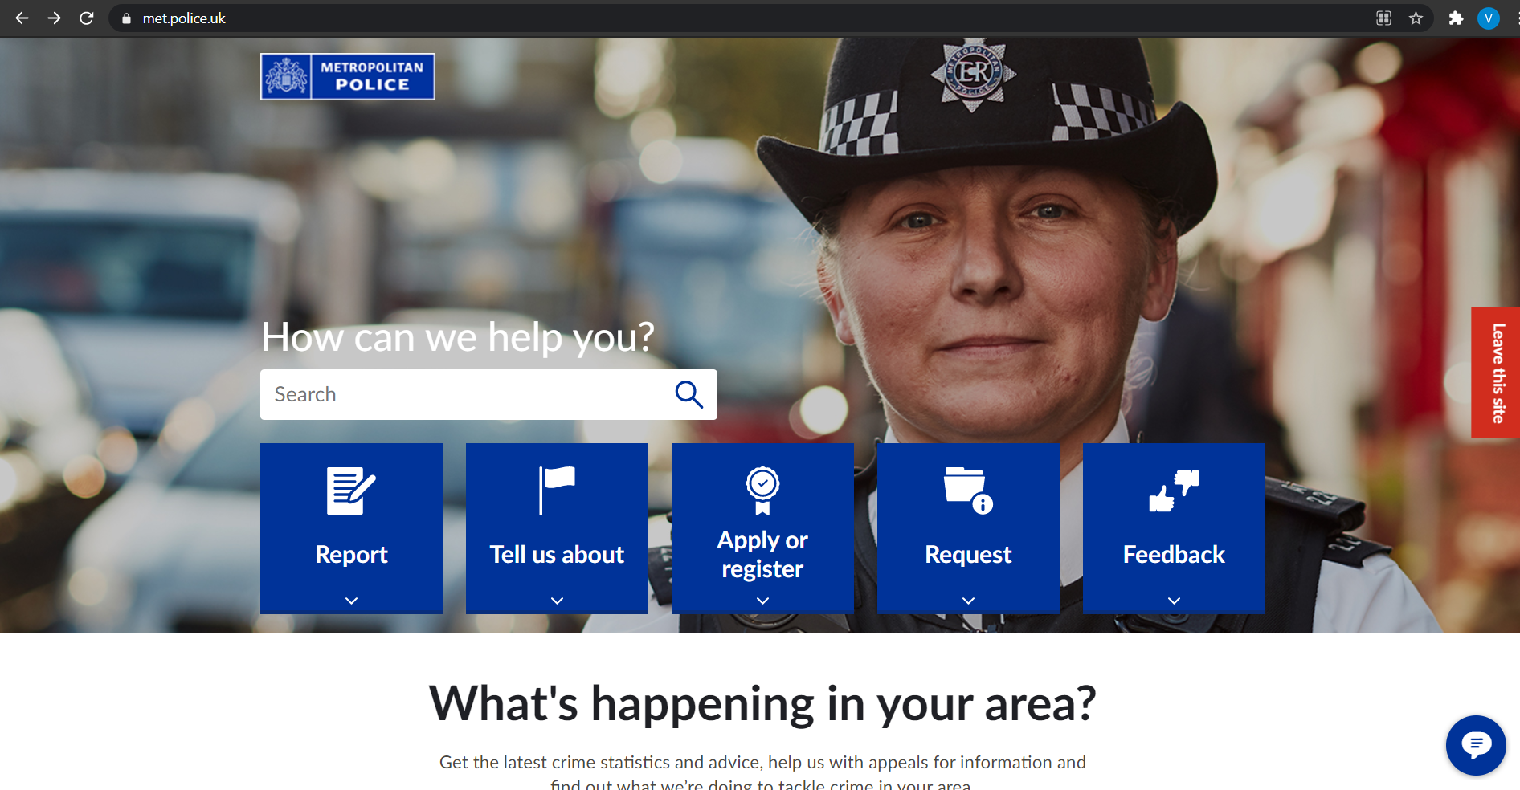
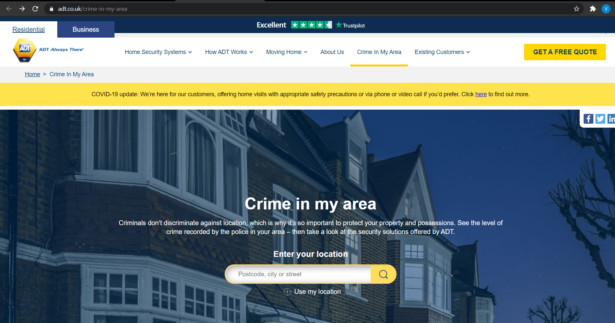
Existing projects
Fig. [5]
Fig. [6]

Slide 18
Existing
Proposed
This website gives us information about what is happening in our area.
They only provide stats and advice.
Our project will give the safest borough in London on the basis of crime data.
Our project also clusters the 10 most common venue in the neighbourhood of the safest area.

Slide 19
Proposed Project benefits
It gives you an insight of secure places to live in London, based on the crime data.
It also gives you the places of your likeness by clustering them.
The project focuses on people shifting from one country to another.
This project helps investors and businessmen to invest at the right place.
This project helps in the overall development of an area.

Slide 20

Technology used in our project
Machine Learning : We are using K-means clustering algorithm in order to cluster 10 most common venues in the safest borough of London on the basis of their similarities.

Slide 21
Why use K-Means Clustering ?
Relatively simple to implement.
Scales to large data sets.
Guarantees convergence.
Can warm-start the positions of centroids.
Easily adapts to new examples.
Generalizes to clusters of different shapes and sizes, such as elliptical clusters.

Slide 22


Tools used in our project
Python 3 2. Foursquare API

Slide 23
Social Impact
A reduction in the numbers and cost of injuries and violence.
A promotion of health and safety in their community.
A sense of community pride.
People and families to move to their community.
An improvement in the quality of life for themselves and their community.
Plenty of lives saved.
Individuals and families enjoy a sustained quality of life, ongoing participation in work, leisure and educational activities, and preservation of income and assets.

Slide 24
Economical Impact
Government will invest more.
Create an opportunity for business.
Tourism will be promoted.
GDP will increase.

Slide 25
Conclusion
This project helps a person get a better understanding of the neighborhoods with respect to the most common venues in that neighborhood. It is always helpful to make use of technology to stay one step ahead, i.e., finding out more about places before moving into a neighborhood.

Slide 26
References
https://www.un.org/sites/un2.un.org/files/wmr_2020.pdf
https://www.kaggle.com/jboysen/london-crime
https://en.wikipedia.org/wiki/List_of_London_boroughs
https://en.wikipedia.org/wiki/List_of_districts_in_the_Royal_Borough_of_Kingston_upon_Thames
https://www.met.police.uk/
https://www.adt.co.uk/

